Slide 1
Using FirstGlance in Jmol to
Animate ConSurf results
for presentations.
These demonstration slides are available here (as Google Slides) or in a downloadable PowerPoint file (30 MB).
- Eric Martz

Slide 2
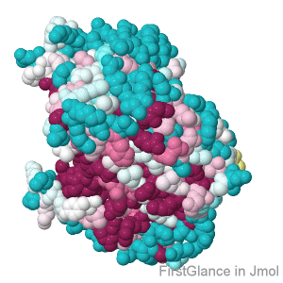
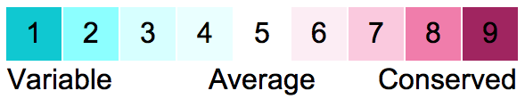
Enolase, an enzyme in glycolysis (4enl), showing evolutionary conservation of the catalytic pocket.
This animation rotates a full 360°, which makes a large GIF file. Rocking back and forth is usually just as satisfactory, and makes a GIF file ⅓ the size. You can choose spinning or rocking in FirstGlance. GIF file is 300 x 300 pixels, 15 MB.
with ConSurf (Tel-Aviv University, Israel)

Slide 3
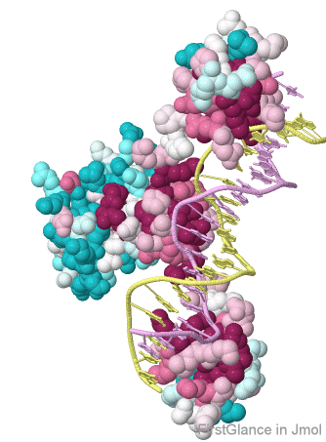

Conservation of the DNA-binding domain of the Gal4 transcriptional regulator protein (3coq). DNA double helix is yellow and violet:
This animation rocks through a 60° angle. This is the default motion when saving animations from FirstGlance in Jmol. GIF file is 450 x 330 pixels, 7 MB.
with ConSurf (Tel-Aviv University, Israel)

Slide 4
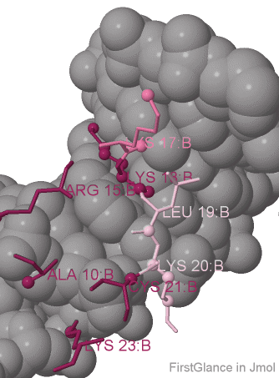
Conservation of Gal4 amino acids contacting DNA (3coq). DNA double helix is gray.
Instructions for seeing conservation of contacts are given in Slide 6.
This animation rocks through a 60° angle. This is the default motion when saving animations from FirstGlance in Jmol. GIF file is 450 x 330 pixels, 7 MB.
with ConSurf (Tel-Aviv University, Israel)

Slide 5
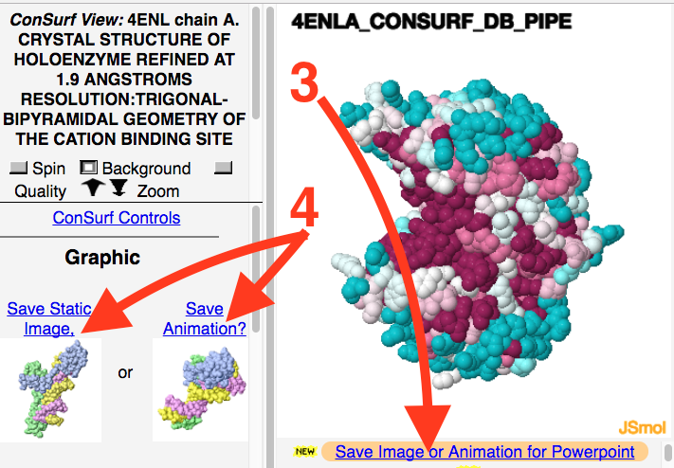
How?
1. Submit a job to the ConSurf server.
2. After your job finishes, under Final Results, click the link View ConSurf Results with FirstGlance in Jmol.
3. Click Save Image or Animation for Powerpoint.
4. Follow instructions.
5. After the animated GIF file is saved to your computer, drag and drop it into a slide. It will animate automatically in Google Slides. You must project it to animate in Powerpoint.
with ConSurf (Tel-Aviv University, Israel)

Slide 6
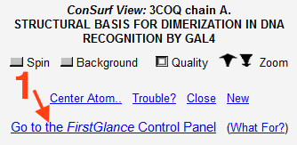
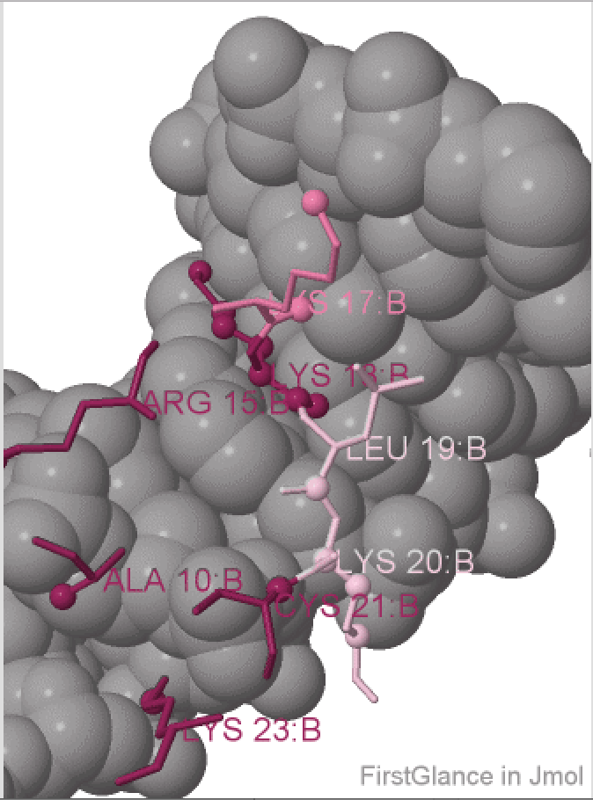

How to visualize conservation of contacts:
While visualizing the results of your ConSurf job in FirstGlance in Jmol:
1. Click the link Go to the FirstGlance Control Panel.
2. If you use Java, animations will be generated much faster. Start a Java session from the Preferences tab.
3. Click on the Tools tab at the top.
4. Click Contacts and Non-Covalent Interactions.
5. Follow instructions. After you Show Atoms Contacting Target, there are many options. Note the checkbox* to apply ConSurf Colors to the contacting residues.
*At the top of the lower left panel.
with ConSurf (Tel-Aviv University, Israel)

Slide 7
Here is the conservation color key. Copy and paste it into your slides as needed.
with ConSurf (Tel-Aviv University, Israel)

Slide 8
End of demonstration examples.
Questions? Ask emartz at microbio.umass.edu
How to save animations from FirstGlance in Jmol.

